Slide 1

TOUCH POINTS 101

Slide 2
WHAT IS A TOUCH POINT?
“TOUCH” Hours are any volunteer activity that works to improve the health and wellness of a community which incorporates osteopathic tenets, awareness, principles, and practice
Translating Osteopathic Understanding into Community Health (TOUCH) is a national initiative of the Council of Osteopathic Student Government Presidents (COSGP).
The AOA controls the rules and regulations for TOUCH points, not LECOM!

Slide 3
IMPORTANCE OF TOUCH POINTS
Through the TOUCH Program students:
01
02
03
04
05
Leave their campuses to serve their communities
Interact with future patients
Learn about the needs of their communities
Teach others about osteopathic medicine
Advocate for the osteopathic profession

Slide 4


TOUCH VS VOLUNTEER HOURS
TOUCH hours are for any event that gives back to the community
Volunteer hours are for any event that gives back to the LECOM community – aka only impacts the students or faculty.
(Including the golf tournament)
Does NOT qualify for either if:
  Compensated
  Shadowing
  Research
Notes:
TOUCH: extends into the community, promoting health awareness, especially if you're spreading osteopathic values – like volunteering at a health fair or similar event
Volunteer: things for LECOM students or LECOM, like the student ambassador program or things that only benefit LECOM

Slide 5
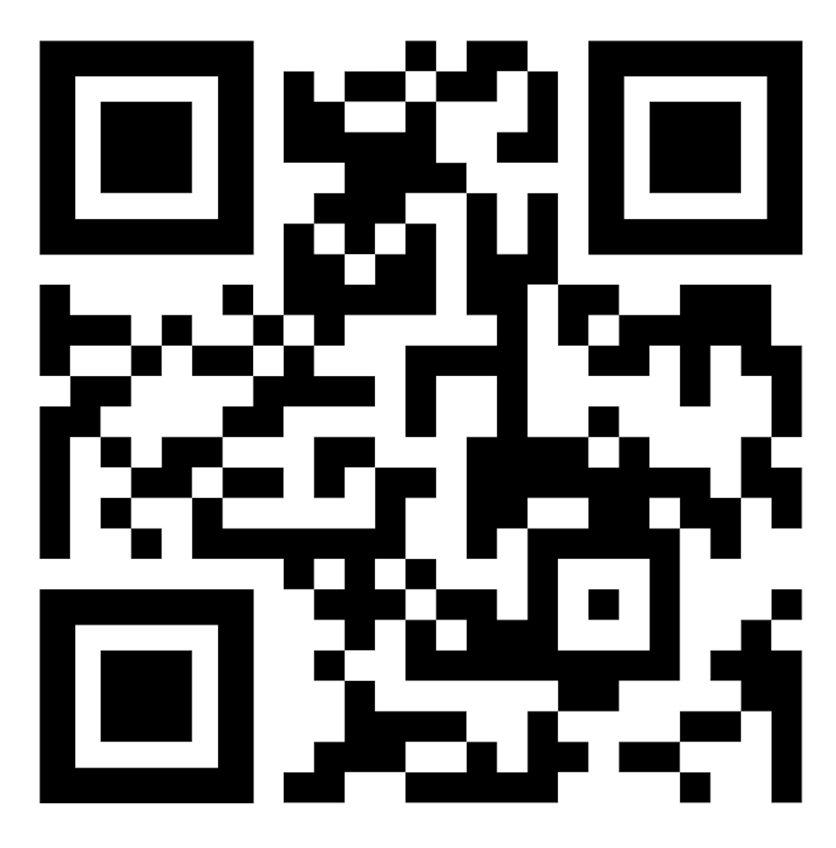
Common Questions
Fostering animals can be counted for a maximum of 2 TOUCH hours per day
1 TOUCH Hour per blood drive donation (when donating)
2 TOUCH Hours for donation drives regardless of the amount/items donate
  - May only accumulate 10 total hours in donation drives per TOUCH Cycle
This powerpoint is an overview. Go to the QR code for the full TOUCH rules.

Slide 6
DOES NOT QUALIFY AS TOUCH HOURS
Giving campus tours to COM interviewees (student ambassadors)
Organizing trips for the community with no clear health/osteopathic principles benefit
Shadowing physicians in a private practice, clinic, or hospital environment
Research activities that do not directly involve the community (ie studying lipid levels and rationalizing it that the findings will help benefit the community does not count)
Staying after your shift to “help out” while on rotations
Organizing campus meetings for clubs that affect only students or planning student only events
Online fundraising or posting on social media.
Tutoring peers/classmates
Conference attendance
TRAVEL TIME!!!
Bonus hours for any event.

Slide 7
ADDITIONAL AOA REGULATIONS
TOUCH Hours include 100% of qualified event hours plus 50% of planning hours for a qualified event if on a committee or member of a board.
Student TOUCH Hours should be submitted to the online database within one (1) month of the activity or date of service.
The TOUCH year will extend from May 1 to April 30 of the next year. The required hours must be completed within the TOUCH year. Anything submitted after will be denied
Hours completed by first year medical students during the summer before matriculation are not eligible.
Completed hours may not be carried over from one academic year to the next.
Please reference https://www.aacom.org/become-a-doctor/resources-for-medical-students/cosgp/touch-program/touch-program-rules-and-regulations

Slide 8
HOW TO SUBMIT TOUCHPOINTS
GivePulse website houses submissions
https://aacom.givepulse.com/group/1149158-american-association-of-colleges-of-osteopathic-medicine-aacom
Each student is responsible for submitting their own hours
The COM Coordinator approves/denies those hours
The National TOUCH Coordinator makes final decision on submissions

Slide 9
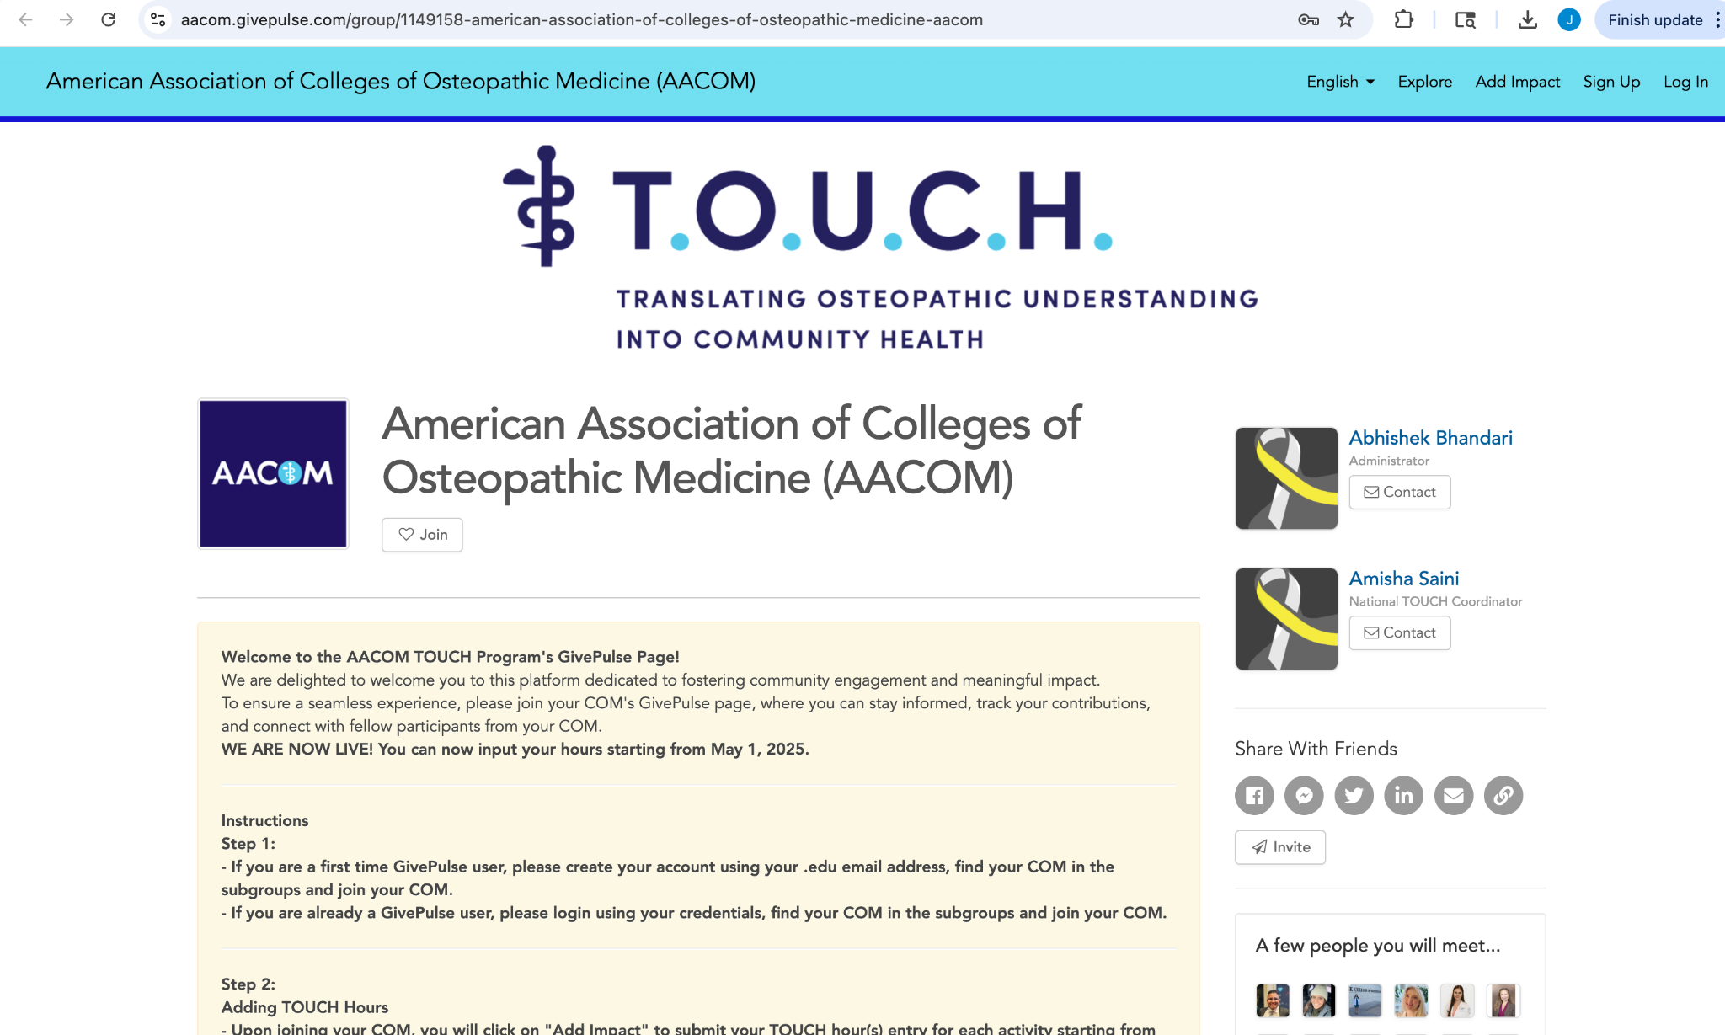
HOW TO SUBMIT TOUCH POINTS
Log in to the website
https://aacom.givepulse.com/group/1149158-american-association-of-colleges-of-osteopathic-medicine-aacom
If you don’t have an account, sign up, or email me!
Use your lecom email when signing up for an account

Slide 10
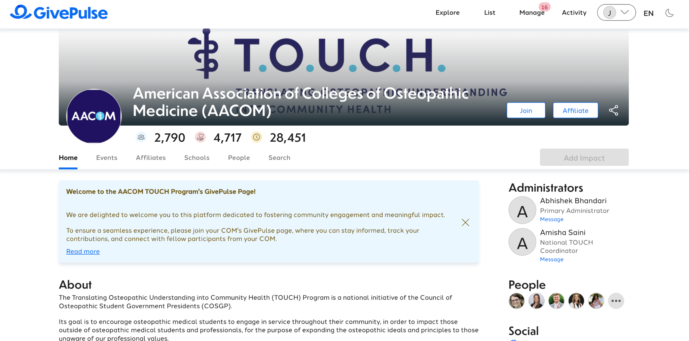
STEP 1: NAVIGATING THE PAGE
Make sure you are on the AACOM page
Navigate to “Schools”

Slide 11
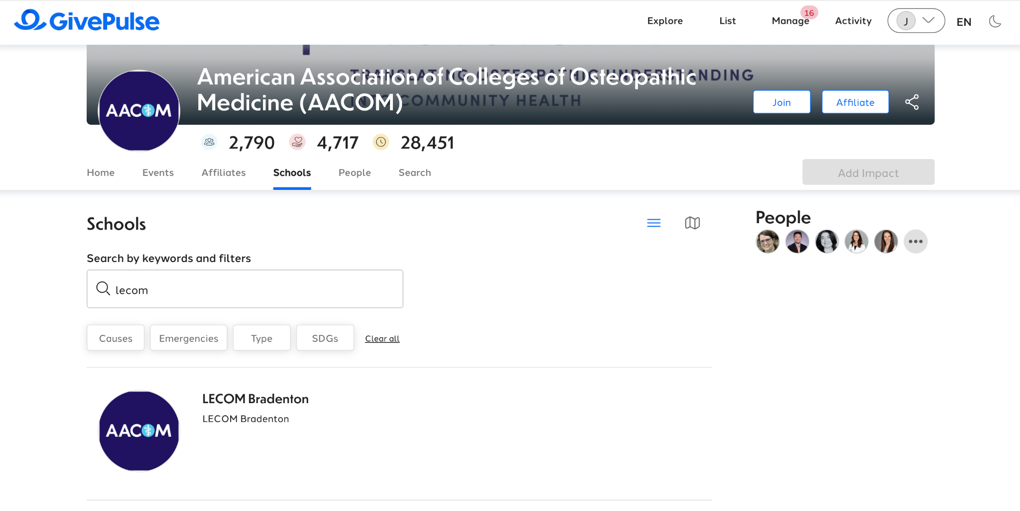
STEP 2: CHOOSE GROUP
Find LECOM Bradenton

Slide 12
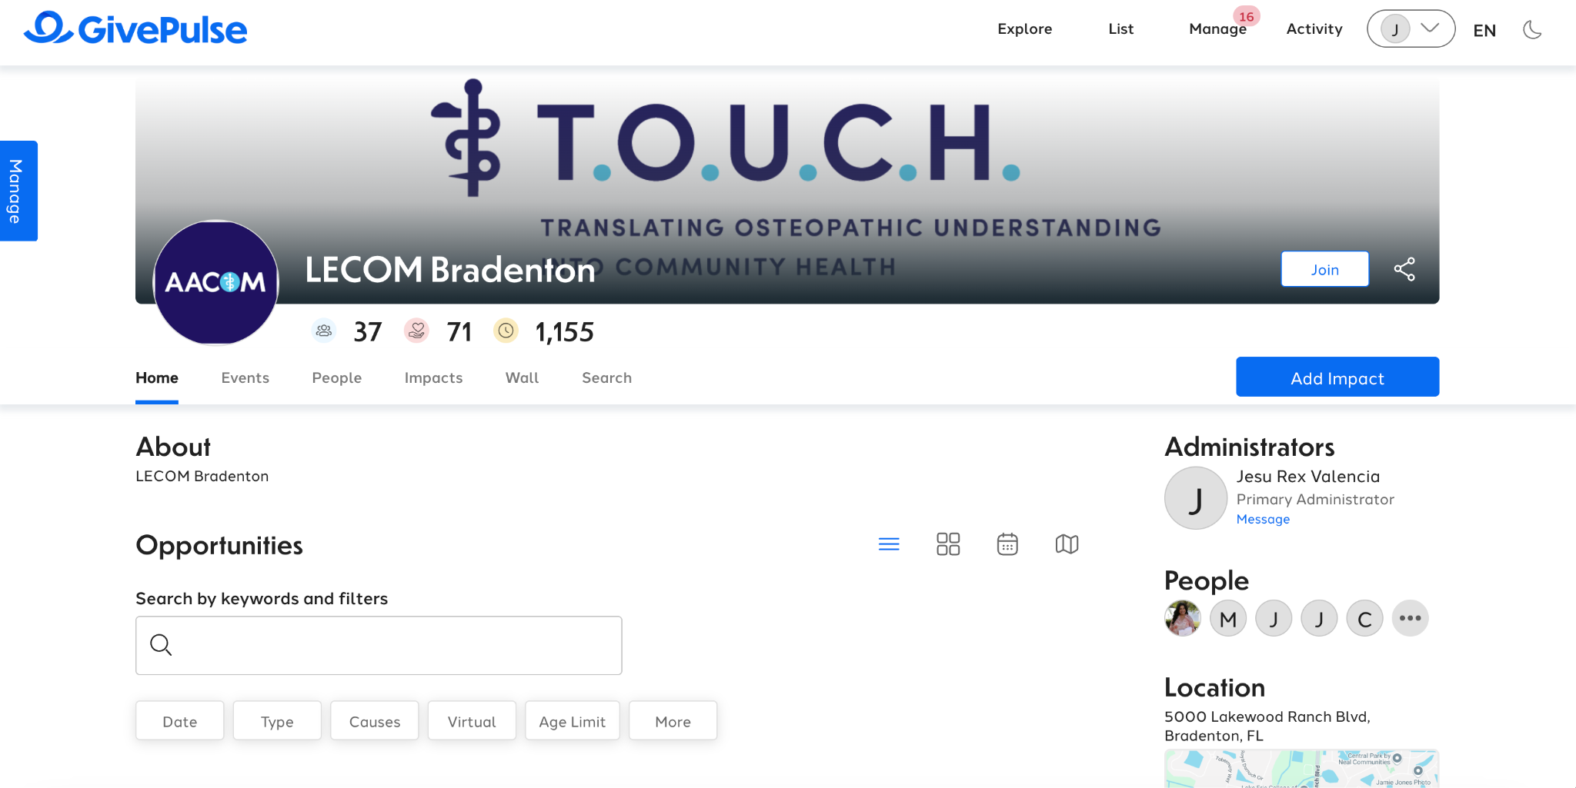
STEP 2: CHOOSE GROUP
Click “Add Impact”

Slide 13
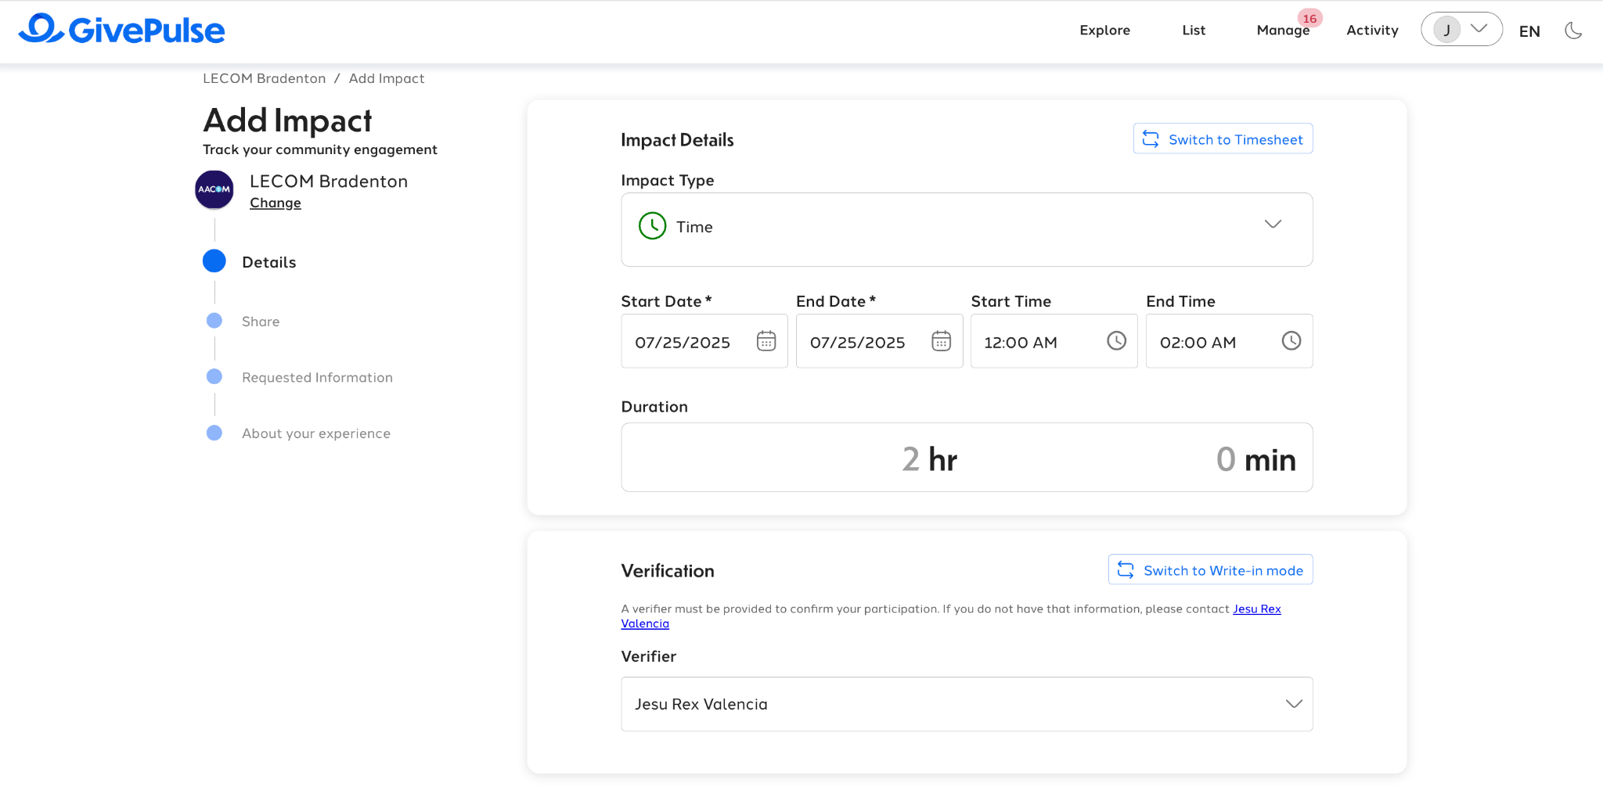
STEP 3: ADDING THE INFORMATION
Input Time and Date in “Details” section
Verification will be from school TOUCH Coordinator
  Do not switch to “Write in mode”!
Can leave “Share” section as is

Slide 14
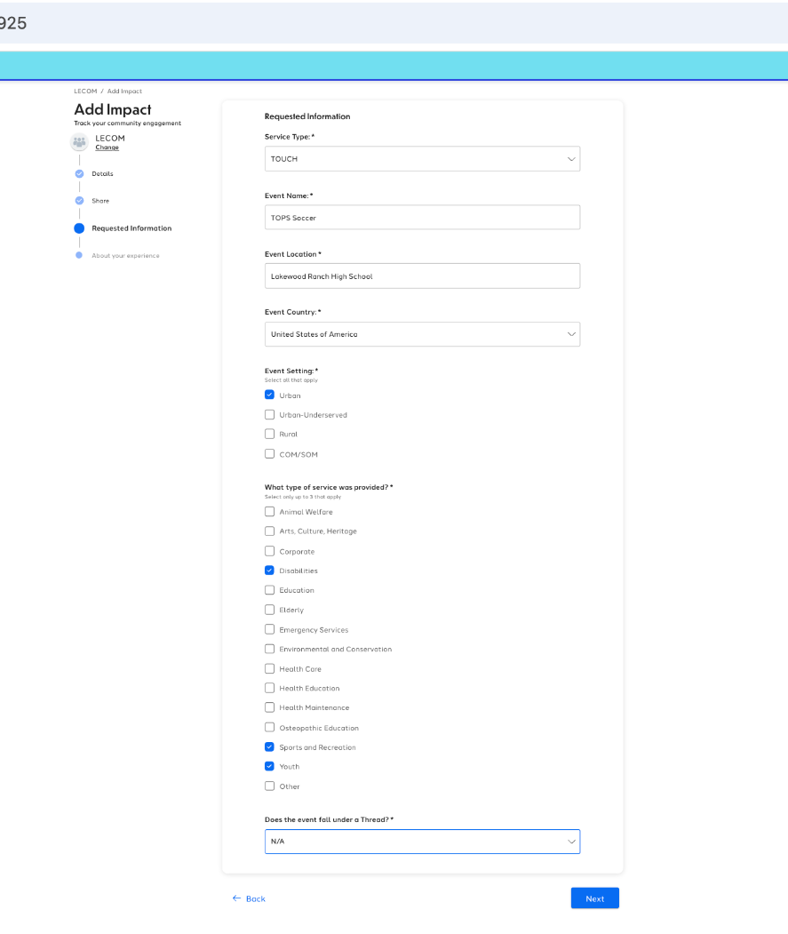
STEP 3: ADDING THE INFORMATION
When submitting an event please include:
  “TOUCH vs Volunteer”
    See TOUCH rules
  The location of the event
  Setting, Type of Service
  Threads
    See TOUCH rules

Slide 15
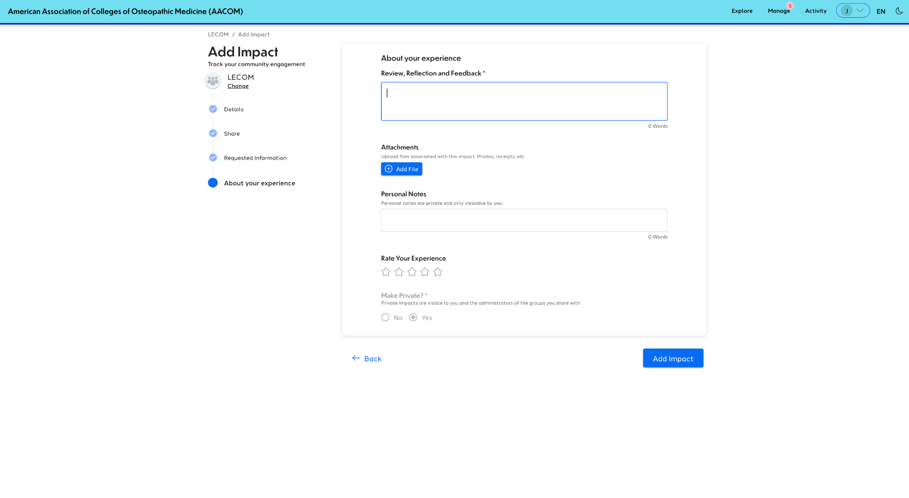
STEP 4: DESCRIPTION AND NOTES
Review, Reflection, and Feedback:
  A description of the event, how you participated, and who it impacts.
If the event was completed over the course of a week or a few days, list out every day it was completed and the number of hours it was completed each of those days

Slide 16
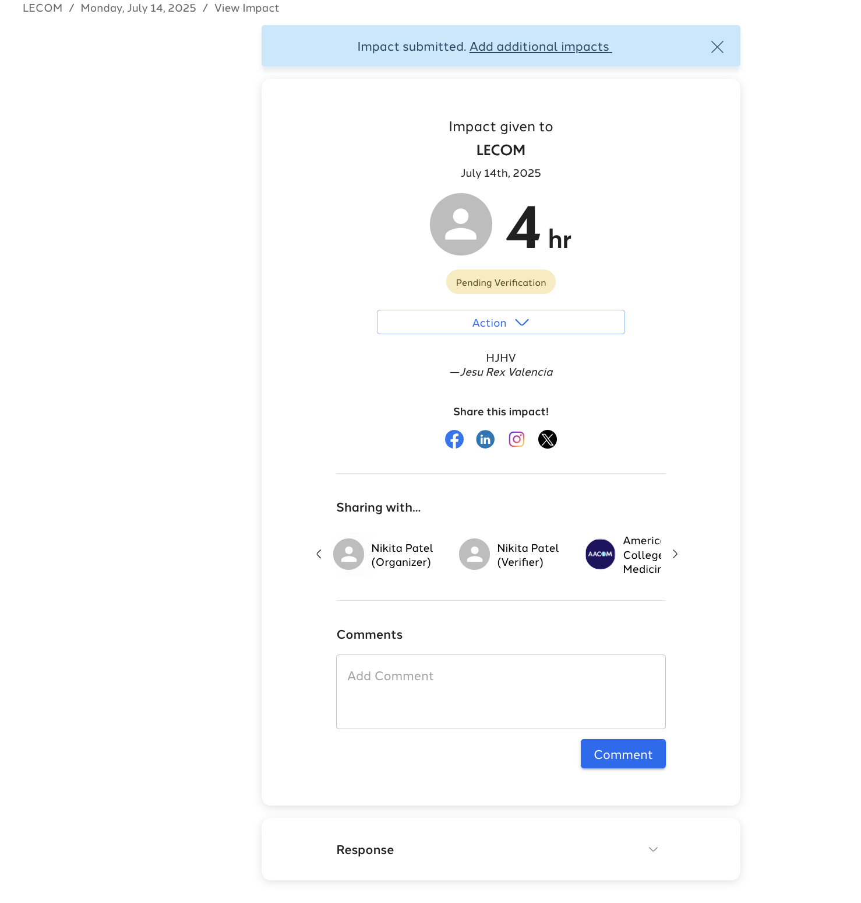
STEP 5: SUBMITTING THE HOURS
Hit “Add Impact”
Your hours will be sent to me for approval

Slide 17
DISPUTES
Students may dispute whether their activities should be counted as TOUCH hours
The contesting student has the right to dispute approved or denied hours
The first level of dispute resolution is with the VP 1, who will serve as impartial decision-makers as needed
Final decision will be made by the National TOUCH Coordinator

Slide 18
TOUCH Awards
If the standards are met with satisfaction, the student will receive a recognition signifying their completion of their commitment to community service
  Silver Recognition = 50+ hours
  Gold Recognition = 100+ hours
  Platinum Recognition = Individual that has dedicated the most time to service at each COM
A letter of recommendation will also be sent to the Dean from AACOM suggesting the Dean include the student’s commitment to service in his/her MSPE (Medical Student Performance Evaluation)

Slide 19
IF CAUGHT FALSIFYING A TOUCH RECORD
First Offense:
  Receive a warning from the national TOUCH coordinator
Second or Subsequent Offense:
  Will receive no credit for previous hours
  Be deemed ineligible for TOUCH recognition the remainder of the TOUCH year
  Student’s falsification will be reported to the student’s college by the national TOUCH coordinator

Slide 20

DEADLINE
The TOUCH year will extend from May 1 to April 30 of the next school year
Completed hours may not be carried over from one academic year to the next
YOU HAVE ONE MONTH FROM WHEN THE EVENT TOOK PLACE TO SUBMIT YOUR HOURS
DO NOT WAIT UNTIL LAST MINUTE TO UPLOAD HOURS!!

